Slide 1
PGP-DSE-JUL-2022
CAPSTONE
PRESENTATION

Slide 2
ABSTRACT
BATCH DETAILS DSE – JUL 2022 (ONLINE)
TEAM MEMBERS NANDAKUMAR A K , SWETHA R VE , NARASHIMMHAN R S ,
JEEVA ANAND B , MUTHURAMPANDIAN R
DOMAIN OF PROJECT SALES ANALYTICS
PROPOSED PROJECT TITLE UNLOCKING SALES POTENTIAL IN LOWA LIQUOR THROUGH
DATA ANALYTICS
TEAM TEAM 04
TEAM LEADER SWETHA R VE
MENTOR NAME PRATIK SONAR

Slide 3
PROBLEM STATEMENT
Lowa Liquor is a retail store that specializes in selling various types of alcoholic beverages. The store has been facing a decline in sales over the past year, and the management team is concerned about the reasons behind this decline. The store wants to identify the factors that are contributing to the decline in sales and find ways to improve the sales performance.
The purpose of the business is to identify the factors that are causing the decline in sales and develop strategies to increase sales revenue. The business wants to analyze sales data and customer behavior to identify patterns and trends that can help them make informed decisions about how to improve their business operations.

Slide 4

VARIABLE CATEGORIZATION
Independent variables
Numerical column : 14
Categorical column :10
Total columns : 24
Target variable
Numerical column : 01

Slide 5
DATA DESCRIPTION
Name of the column | Description
date | Date of the product purchase
store_number | Product sold store number
store_name | Product sold store name
address | Product sold store address
city | Product sold store city
zip_code | Product sold store zip code
store_location | Product sold store location
county_number | Product sold country number
County | Product sold country
Category | Category number of Product sold
category_name | Category name of Product sold
vendor_number | Vendor number for the product distributed to the stores
vendor_name | Vendor name for the product
item_number | item number for the product
item_description | Description of the item sold
Pack | Number of bottles in a pack
bottle_volume_ml | Quantity per bottle
state_bottle_cost | Cost of the bottle state wise (whole sale)
state_bottle_retail | Cost of the bottle retail
bottles_sold | Number bottle bought
sale_dollars | Price in dollar
volume_sold_liters | Quantity sold in litres

Slide 6
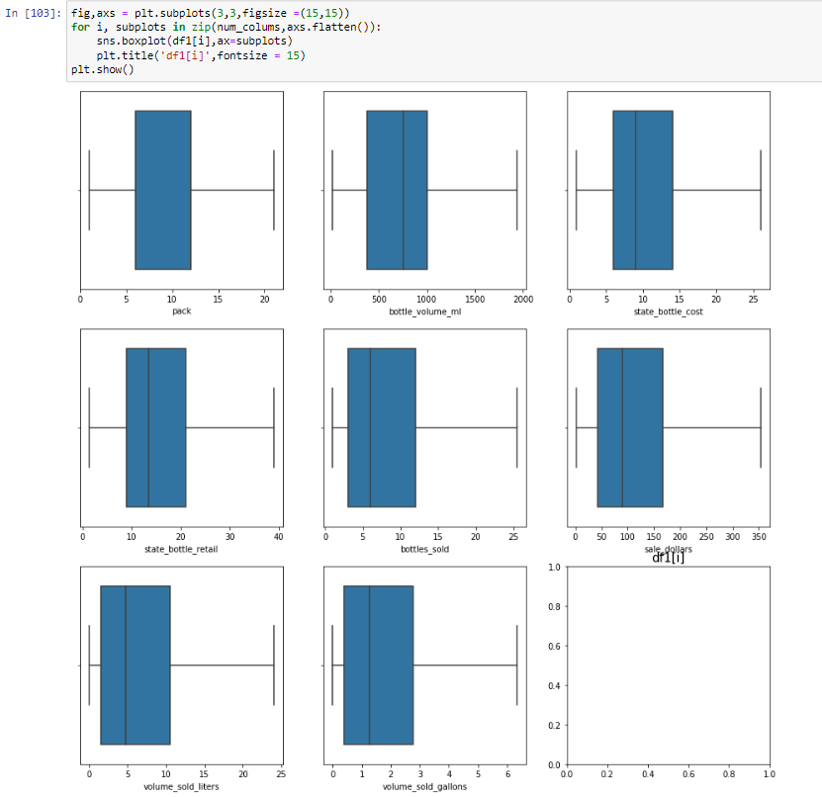
OUTLIERS

Slide 7
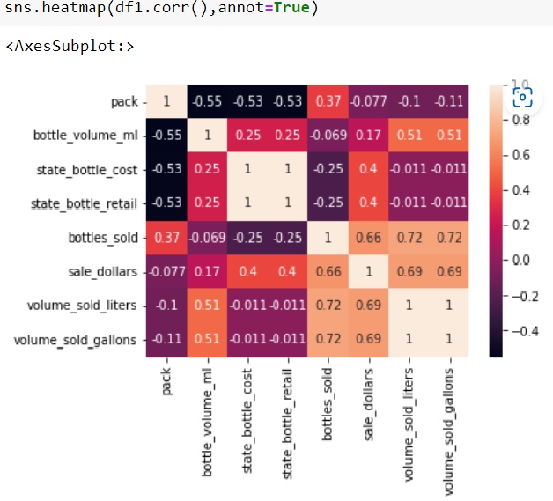
CORRELATION

Slide 8
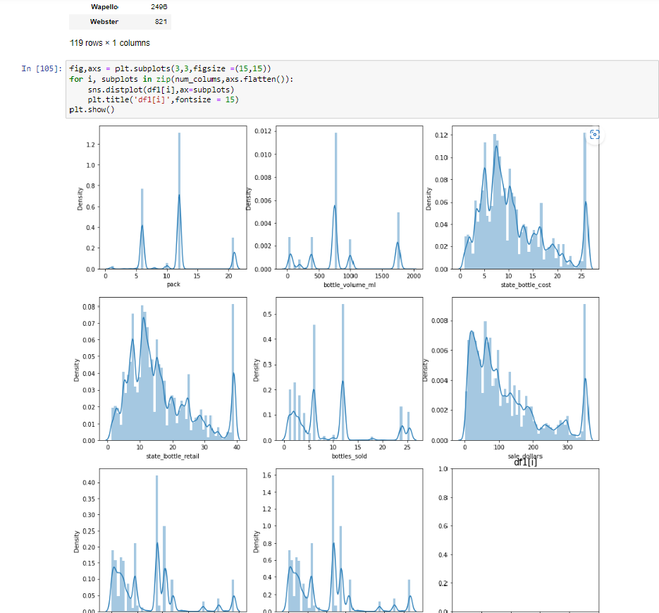
DISTRIBUTION OF VARIABLES

Slide 9
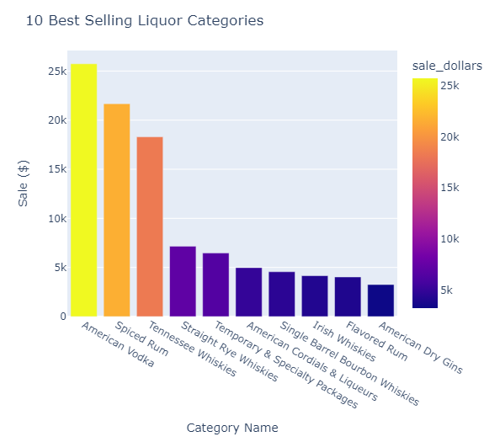
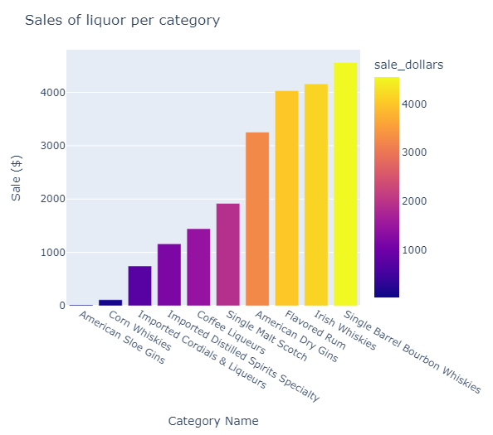
DATA VISUALISATION

Slide 10
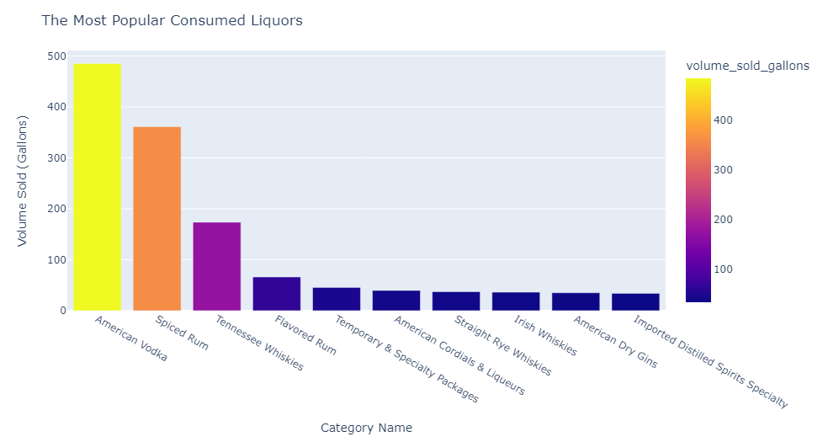
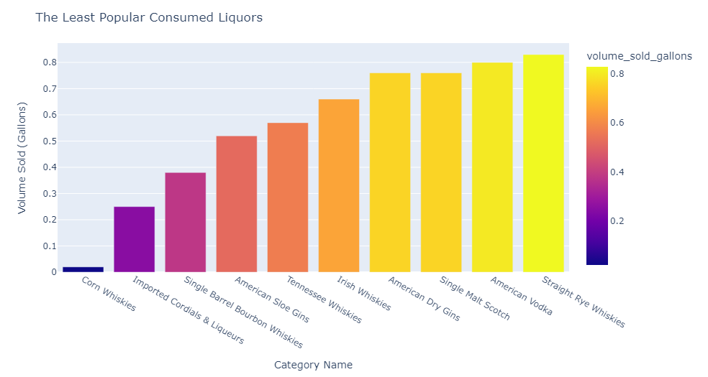
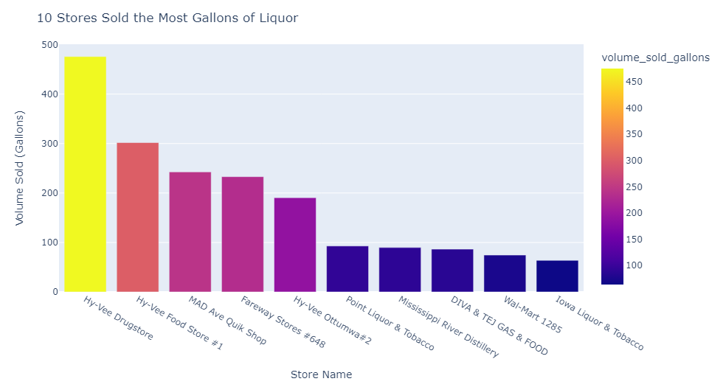

Slide 11
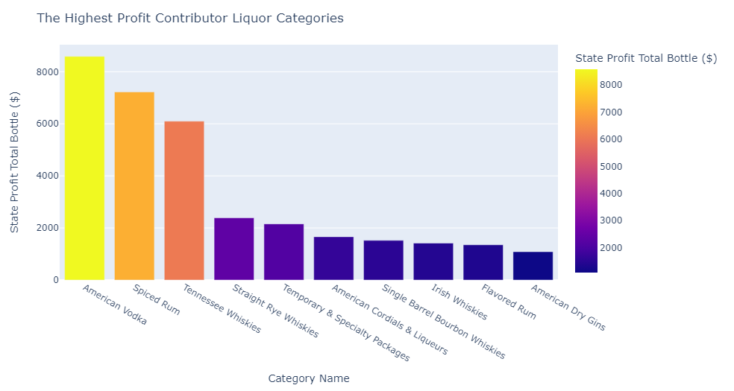
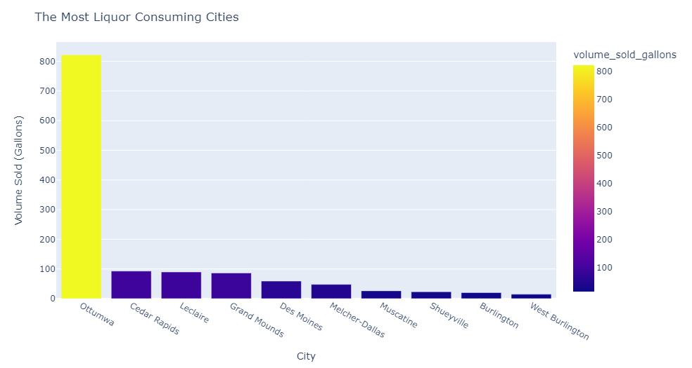
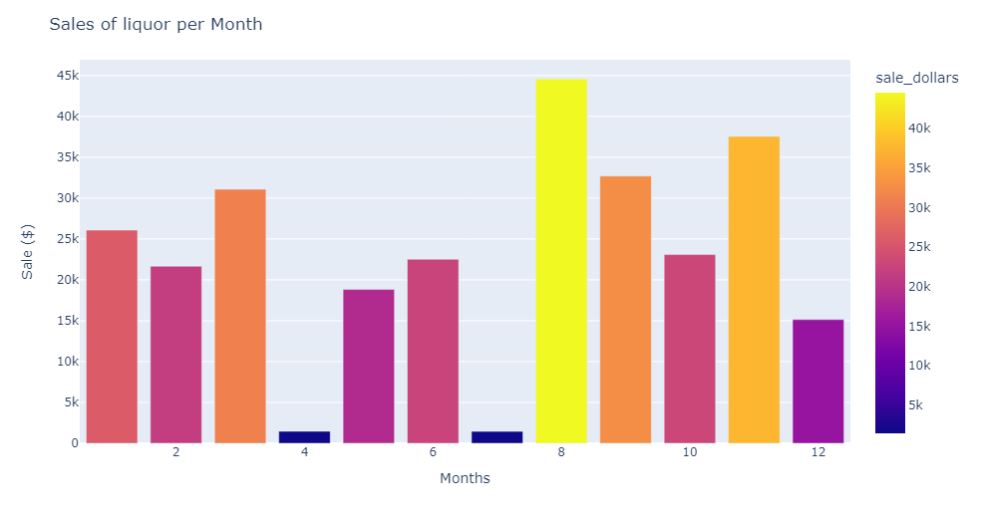

Slide 12
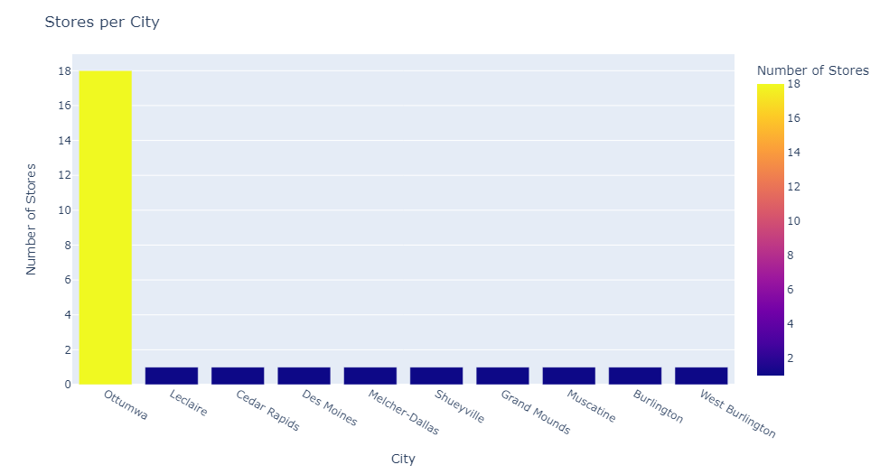
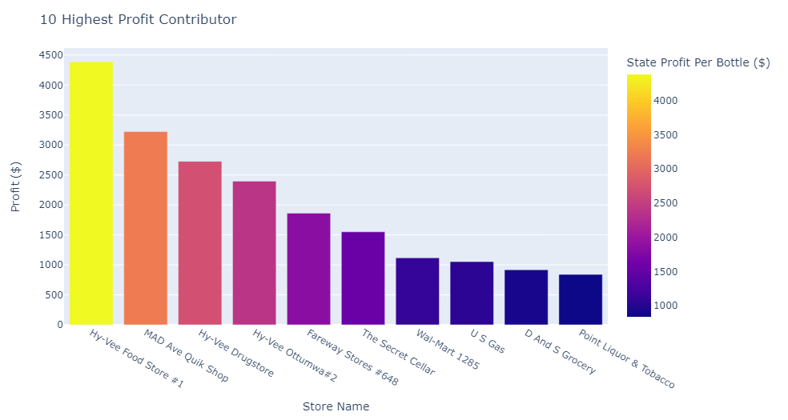
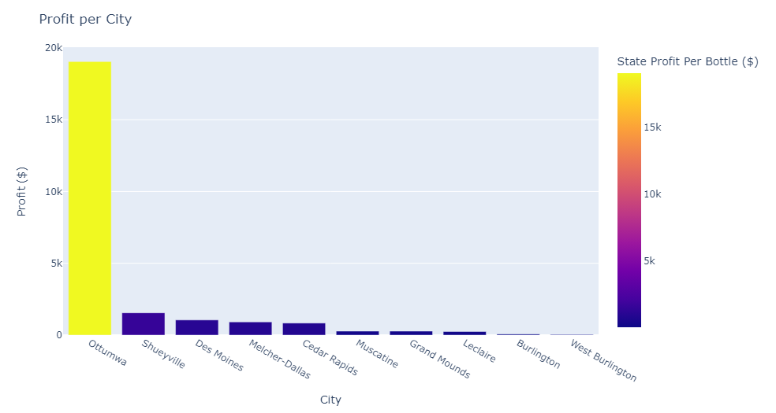

Slide 13
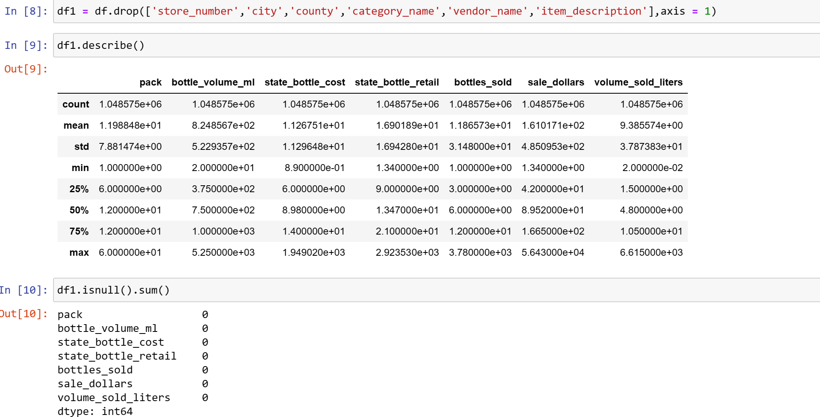
DATA PREPROCESSING FOR MODEL BUILDING

Slide 14
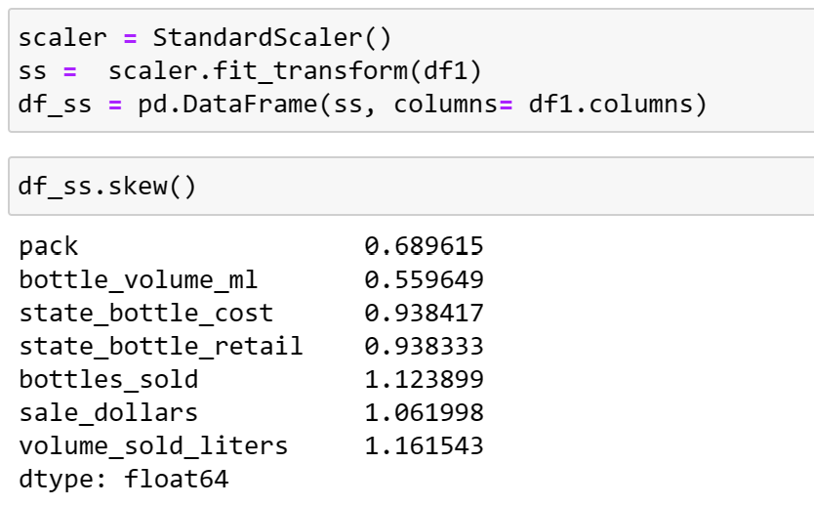
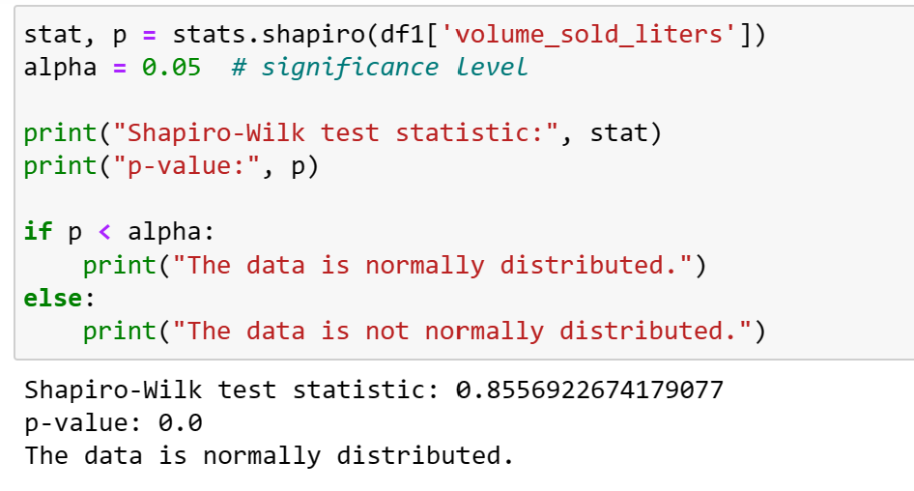
SKEWNESS
STATISTICAL TEST

Slide 15
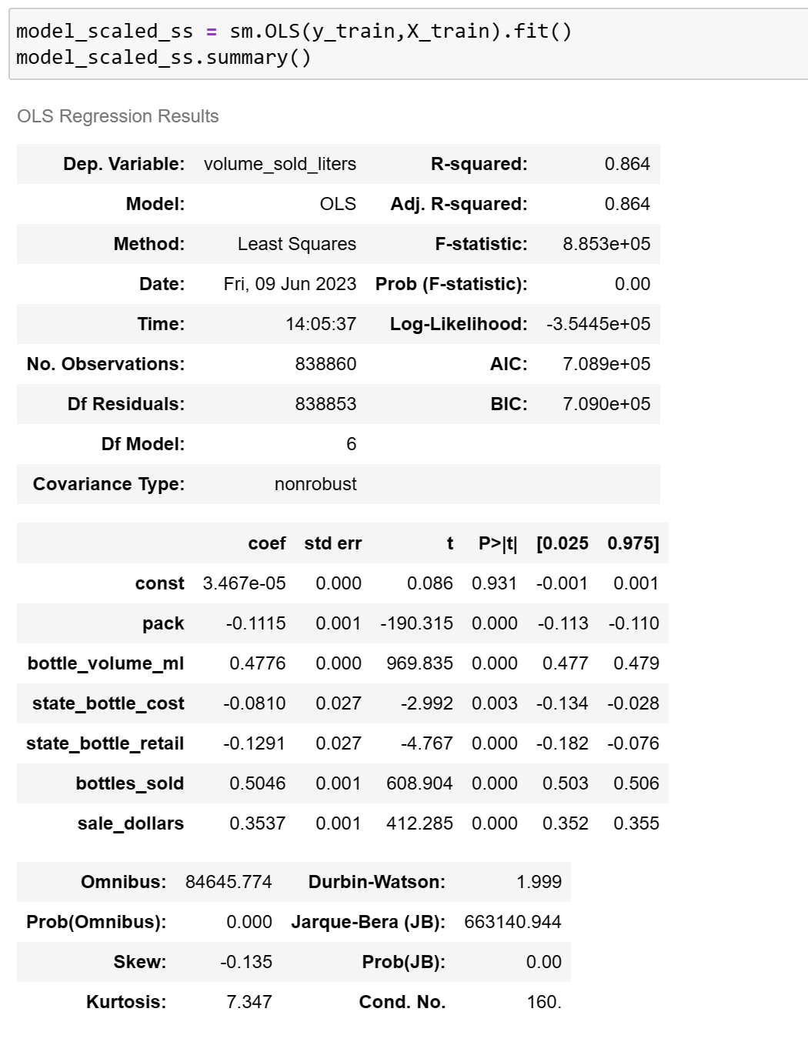
BASE MODEL
Inference of Base Model
R-squared – 0.86 (Good Score)
Durbin-Watson – 1.99 (No Autocorrelation)
Cond No – 160 (Low Multicollinearity)
P-Value – less than 0.05(All variables are significant)
From the above score our Model is fitted perfectly.

Slide 16
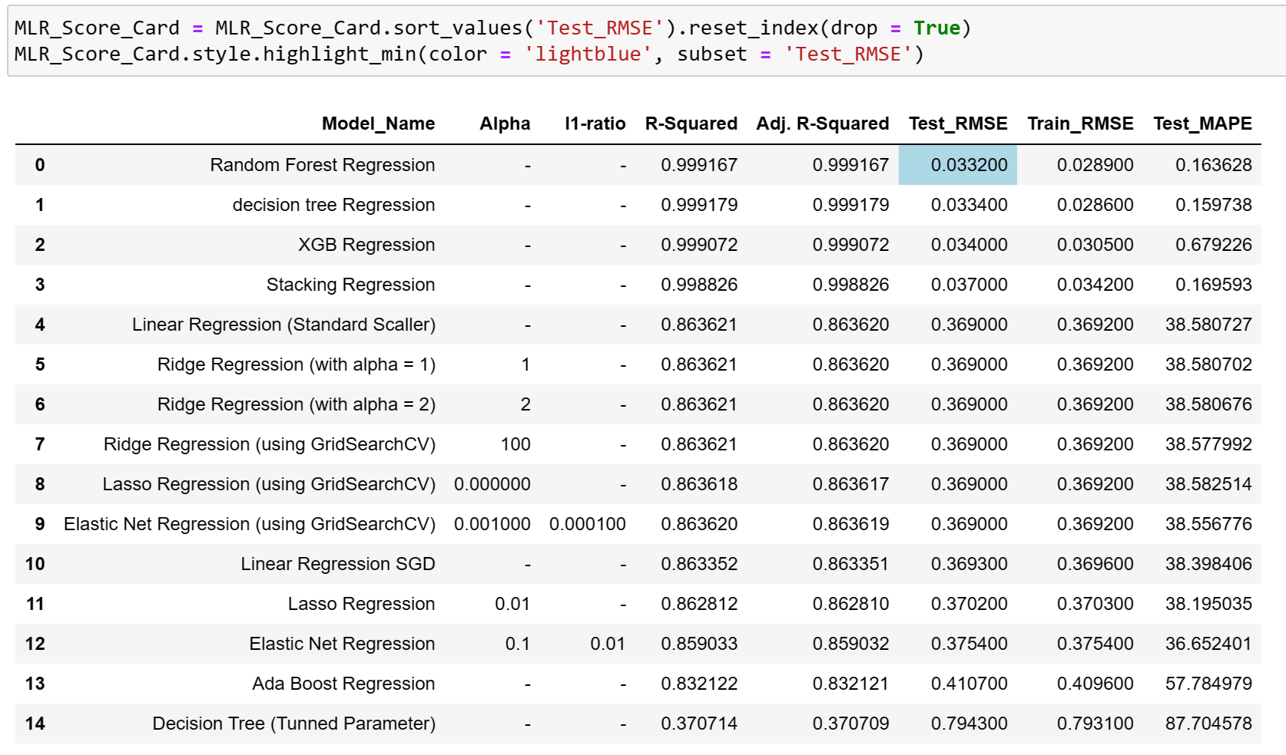
FITTING MULTIPLE REGRESSION MODEL

Slide 17
CONCLUSION
Based on the above information, the random forest regression model seems to have achieved excellent performance based on several evaluation metrics:
1. R-squared: The R-squared value of 0.99916 indicates that the model explains approximately 99.916% of the variance in the target variable. A high R-squared value suggests that the model fits the data very well, and the majority of the variability in the target variable is captured by the model.
2. Adjusted R-squared: The adjusted R-squared value of 0.99916 is identical to the R-squared value in this case. This suggests that the model contains no unnecessary variables or overfitting issues, as the adjusted R-squared is usually lower than the R-squared when there are excessive variables in the model.
3. Test RMSE: The test root mean squared error (RMSE) of 0.0332 indicates that, on average, the model's predictions have an error of approximately 0.0332 units when applied to unseen test data. A lower RMSE value suggests better predictive performance, so the provided RMSE value is relatively low.

Slide 18
4. Train RMSE: The train RMSE of 0.0289 represents the average error of the model's predictions on the training data. A lower train RMSE suggests that the model is fitting the training data well, with small discrepancies between the predicted values and the actual values.
5. MAPE: The Mean Absolute Percentage Error (MAPE) of 0.163 indicates the average percentage difference between the predicted and actual values. A lower MAPE indicates better accuracy, and the provided MAPE value is relatively low.
Based on these metrics, the random forest regression model appears to be performing exceptionally well, demonstrating a high level of accuracy and predictive power.
Hence RANDOM FOREST REGRESSOR is predicting ‘Volume sold litre’ well compared to other Regression model.

Slide 19
THANK YOU

